Slide 1
Exploration and selection of appropriate natural or organic alternatives of chemical nanoparticles and their synthesis

Slide 2
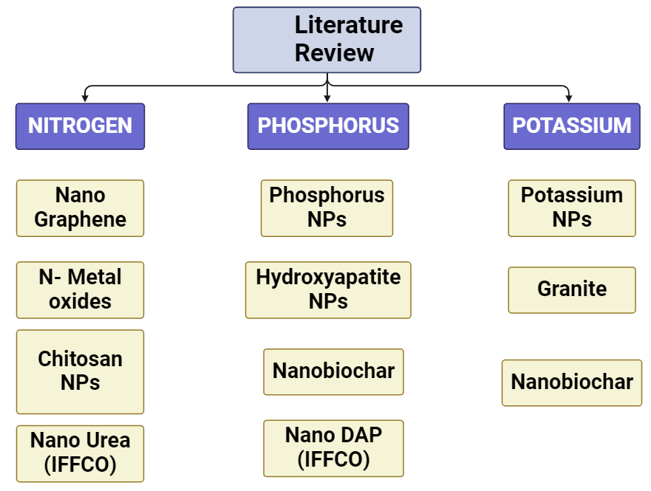

Slide 3
Chitosan
Chitosan is a natural biopolymer derived from chitin, which is found in the exoskeletons of crustaceans such as shrimp, crab, and lobster. It has gained popularity in various industries due to its unique properties and applications
Chitosan nanoparticles have been studied and explored as a potential alternative nitrogen source in agricultural applications (Abdel et al. 2020)
Chitosan is used in agriculture as a bio pesticide and plant growth enhancer. It can protect crops from fungal and bacterial diseases and can also boost plant immunity. Chitosan-based products are considered eco-friendly alternatives to synthetic pesticides (Sharma et al. 2022)
Chitosan is used as a food additive, primarily for its ability to act as a thickener and stabilizer. It can also be used as a preservative, as it has antimicrobial properties that can extend the shelf life of certain foods
Chitosan is utilized in various biotechnological applications, including the immobilization of enzymes, Textile Industry, Cosmetics, biomedical etc (Hahihashemi et al. 2022)

Slide 4
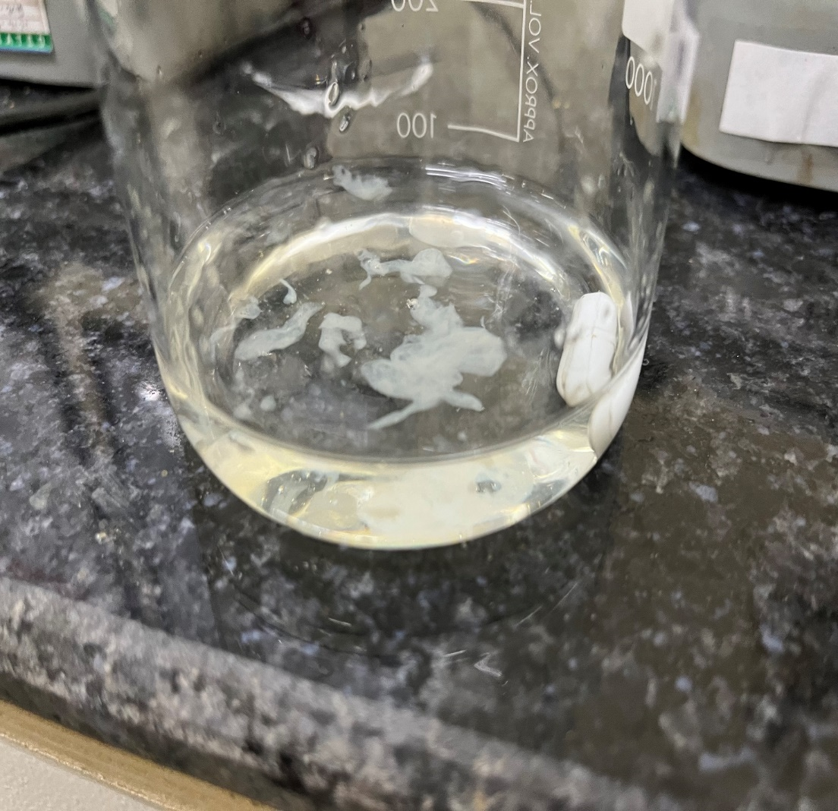
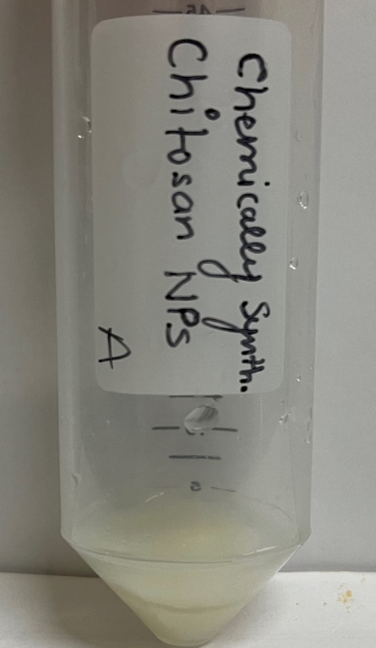
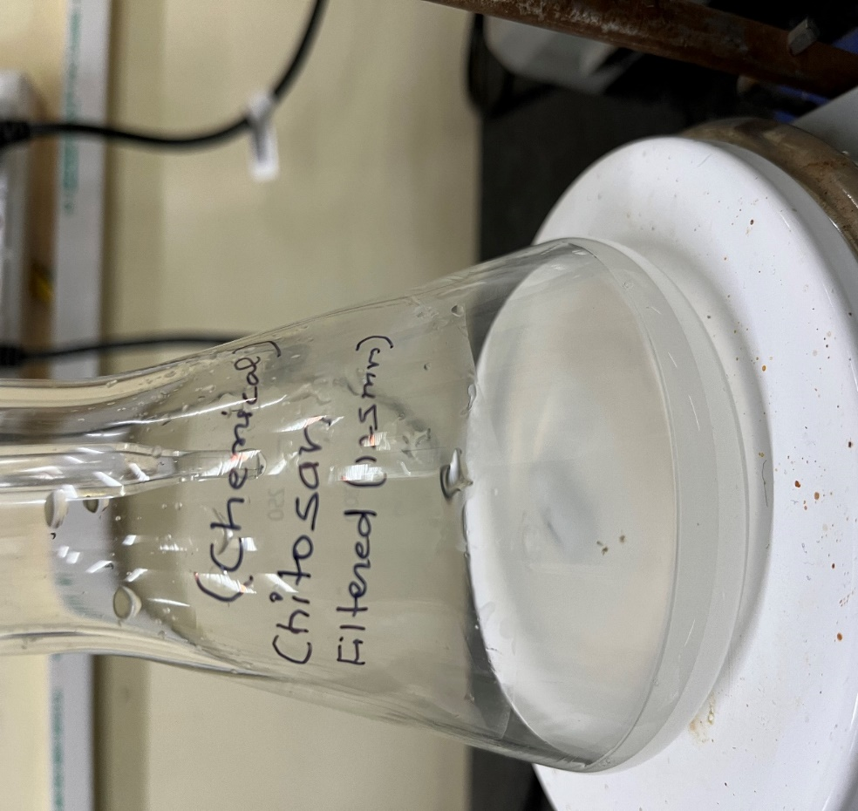
Synthesis of Chitosan Nanoparticles
Shrimp shells waste (Chitosan)
Chitosan + A Acid
Chitosan NPs
Chitosan (0.4%, w/v) was dissolved in 0.5% acetic acid with continuous stirring at 100 rpm. TPP solution was then slowly added to the chitosan solution with stirring. The resulting chitosan nanoparticles (NC) were purified by centrifugation at 10,000 g for 10 minutes and washed three times with HPLC-quality water. The supernatant was discarded, and the NC was stored for further use.

Slide 5
Hydroxyapatite
Hydroxyapatite (HA) is a naturally occurring mineral form of calcium apatite. It is the main mineral component of bones and teeth and is known for its biocompatibility and bioactivity (Abere et al. 2022)
Hydroxyapatite is widely used in orthopedic as a bone substitute material. (Munir et al. 2022) and in various dental applications, including toothpaste and dental fillings (Hannig et al. 2020), (Tina Rodemer et al. 2022)
Hydroxyapatite nanoparticles can be functionalized to act as carriers for drug delivery. Can be targeted to specific tissues or organs, improving drug efficacy and reducing side effects
Hydroxyapatite can be used as a fertilizer additive to improve the nutrient content of the soil. It acts as a slow-release source of phosphorus, an essential nutrient for plant growth (Abdel et al. 2020)
The use of hydroxyapatite in agricultural and medical applications continues to be an active area of research, and advancements in nanotechnology and material science

Slide 6
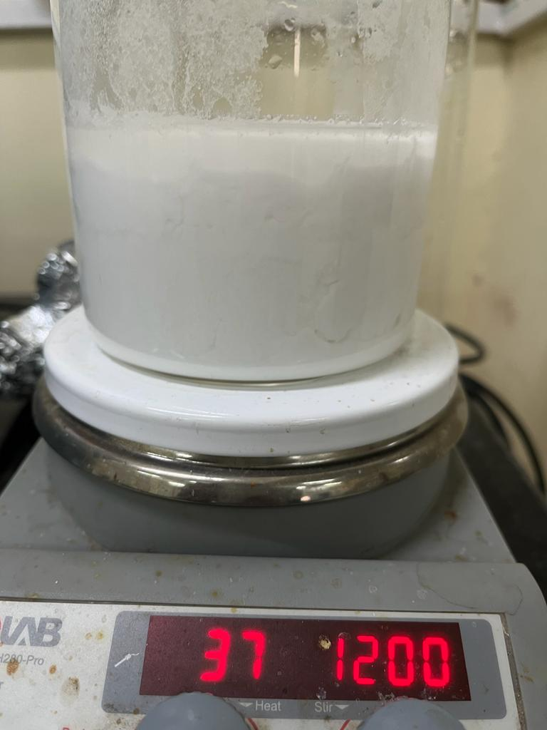
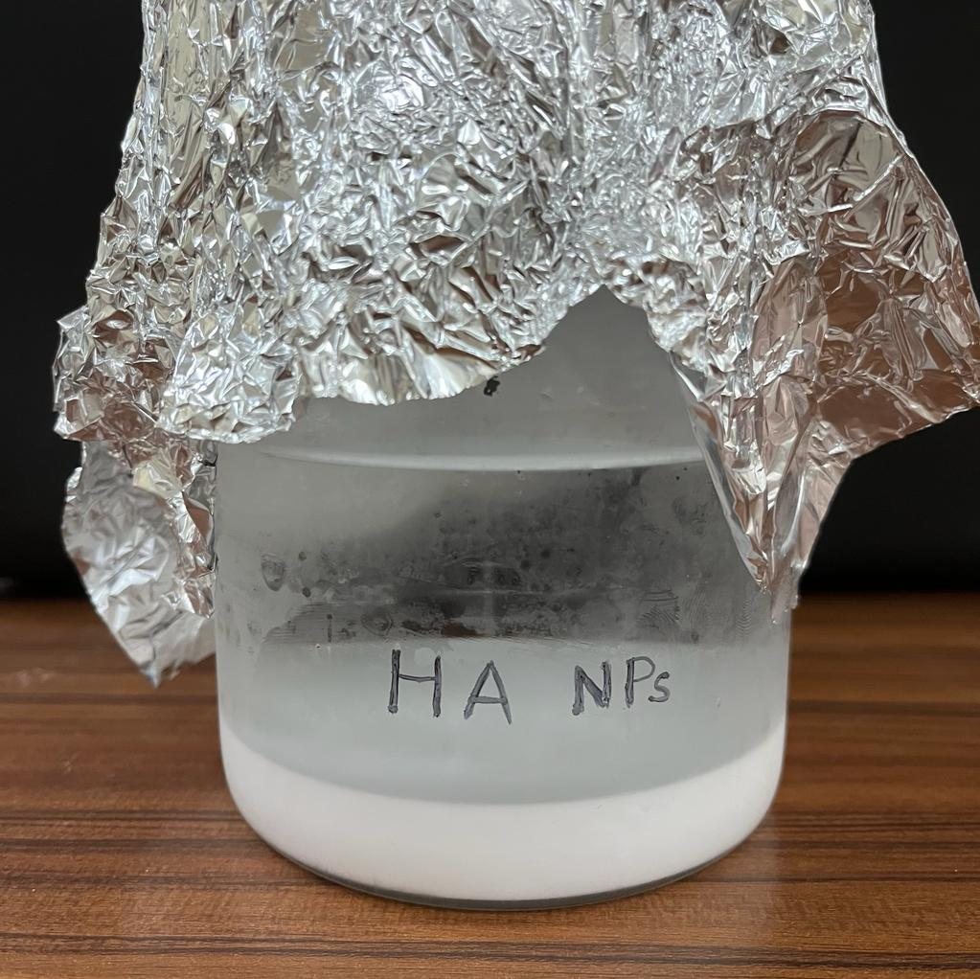
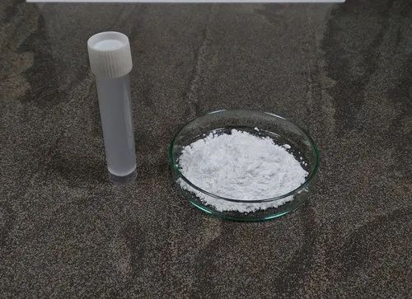
Synthesis Of Hydroxyapatite Nanoparticles
Resulting milky solution
Precipitated hydroxyapatite
Hydroxyapatite Nano Particles
Ortho phosphoric acid was added to calcium carbonate (ES), It was stirred at room temperature. The pH of the solution was maintained. The sample was washed repeatedly and dried in hot air oven (Tarafder et al. 2020)

Slide 7
Biochar
Biochar is a type of charcoal produced through the pyrolysis (heating in the absence of oxygen) of organic materials, such as agricultural waste, wood chips, and plant residues. It has numerous applications in various fields due to its unique properties and benefits
Biochar is widely used as a soil amendment to improve soil fertility, structure, and nutrient retention (Sajid et al. 2020)
Biochar can be used in agriculture to enhance crop productivity. Its ability to retain nutrients and water can lead to better plant growth and higher crop yields (Martinez Gomez et al. 2022)
Biochar can be utilized in wastewater treatment processes to remove pollutants and contaminants from water (Wang et al. 2021)
Biochar production through pyrolysis can generate renewable energy in the form of heat and syngas, which can be used for various purposes (CuongDo et al. 2023)

Slide 8
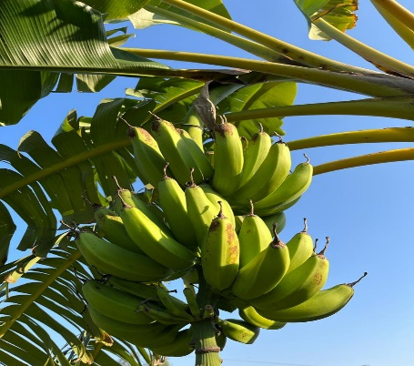
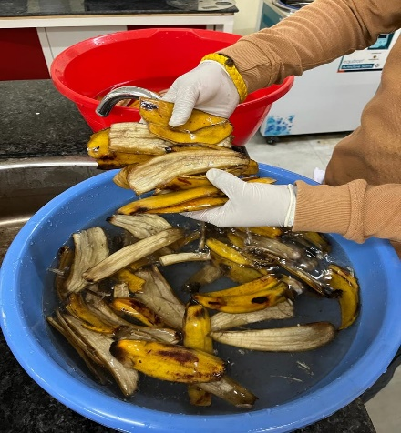
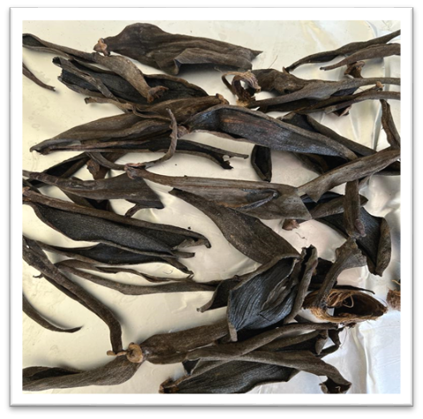
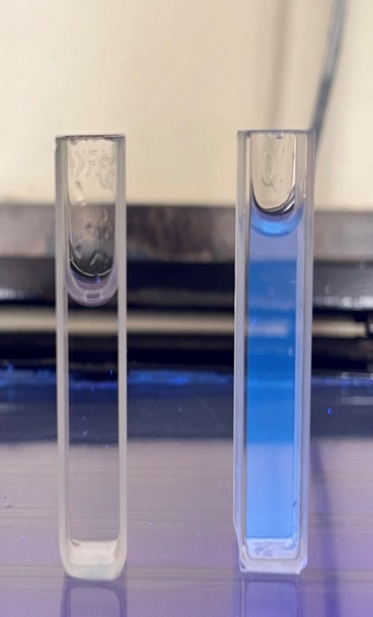
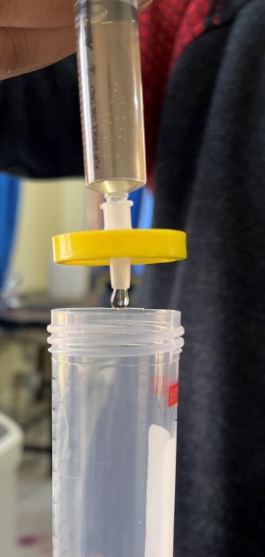
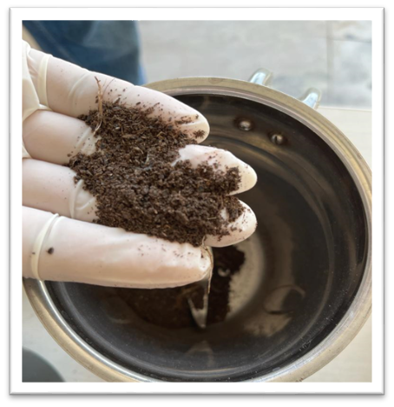
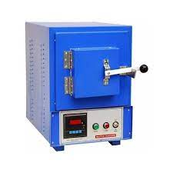
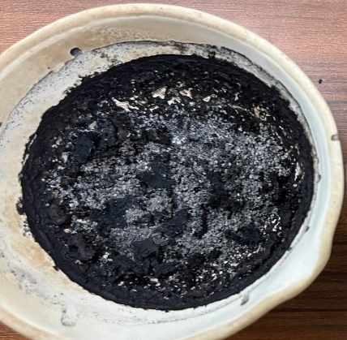
Synthesis of nanobiochar
A
B
C
G
H
D
E
F
(A)Collect banana peel (B)Wash peel (C)Dry the peels (D)Grind the peels (E)Carbonize the peel (F)Crush biochar (G)Activate biochar (H)Filter and store
UIBT
Adarsh
14

Slide 9
Potassium Nanoparticles
Potassium nanoparticles improve the efficiency of nutrient uptake in plants, leading to better growth and higher crop yields (Zhang et al., 2018)
K-NPs enhance soil fertility by improving soil structure, increasing nutrient retention, and reducing nutrient leaching (Huang et al., 2020)
The application of potassium nanoparticles can enhance the resistance of plants to various diseases and pests, reducing the need for chemical pesticides (Liu et al., 2019)
K-NPs promote sustainable agricultural practices by reducing the reliance on chemical fertilizers and minimizing environmental impact (Wang et al., 2021)
Potassium nanoparticles help in retaining moisture in the soil, which is beneficial for plant growth, especially in arid regions (Gao et al., 2020)
The use of K-NPs is a cost-effective alternative to traditional fertilizers, offering long-term benefits for farmers (Chen et al., 2018)

Slide 10
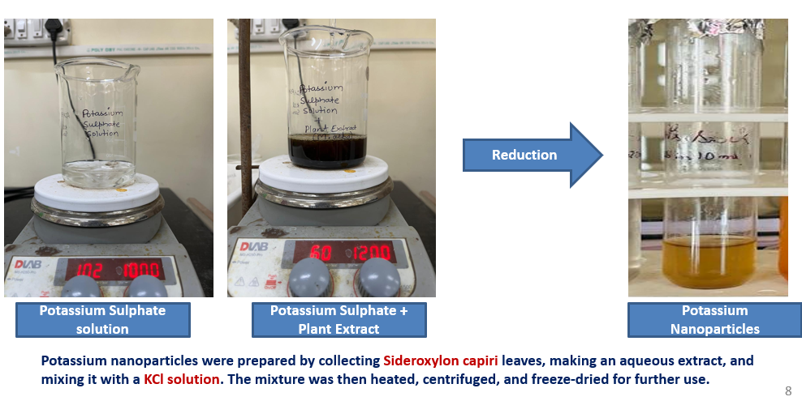
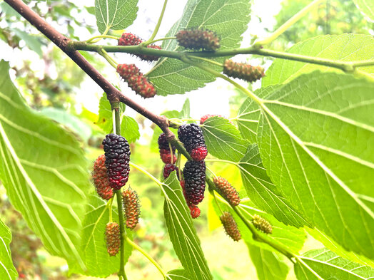
Synthesis of Potassium Nanoparticle (KNPs)
Mulberry leaves (Plant Extract)
Potassium nanoparticles were prepared using Morus alba leaves, an aqueous extract was prepared with distilled water and then added Potassium sulphate. The mixture was heated, centrifuged and air-dried for further use.

Slide 11
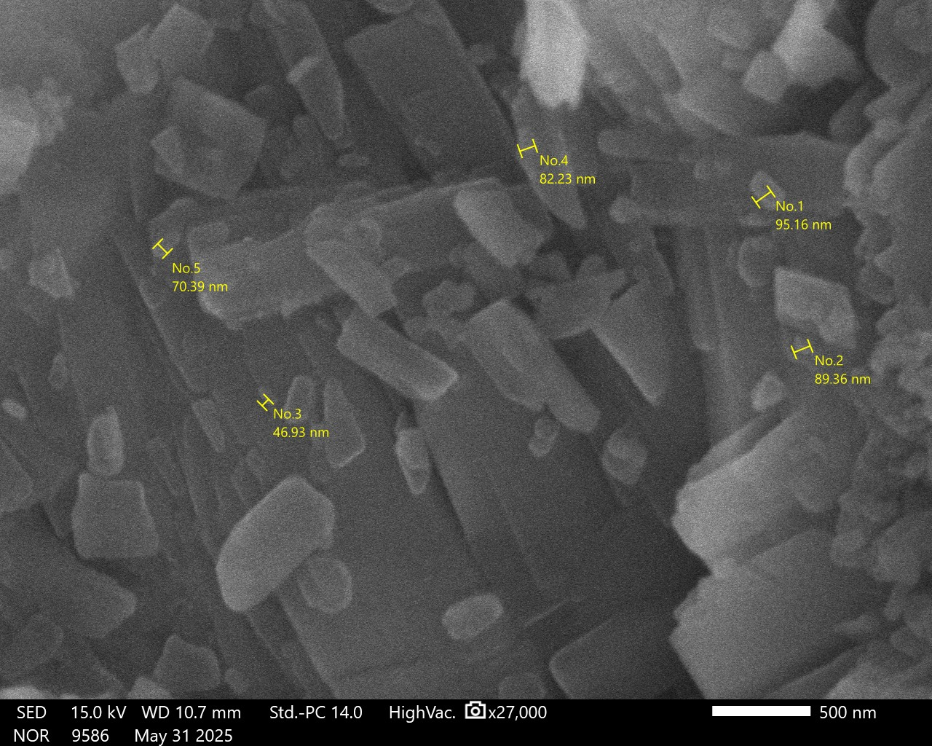
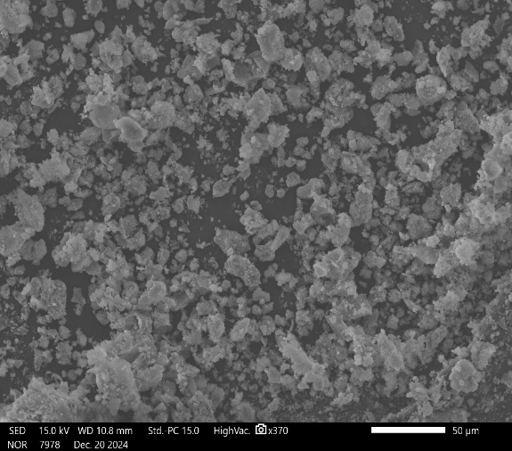
SEM of Hydroxyapatite Nanoparticles
SEM Image of Hydroxyapatite nanoparticles
(SEM analysis revealed nHAP crystallites having Range between 46 nm – 500 nm).

Slide 12
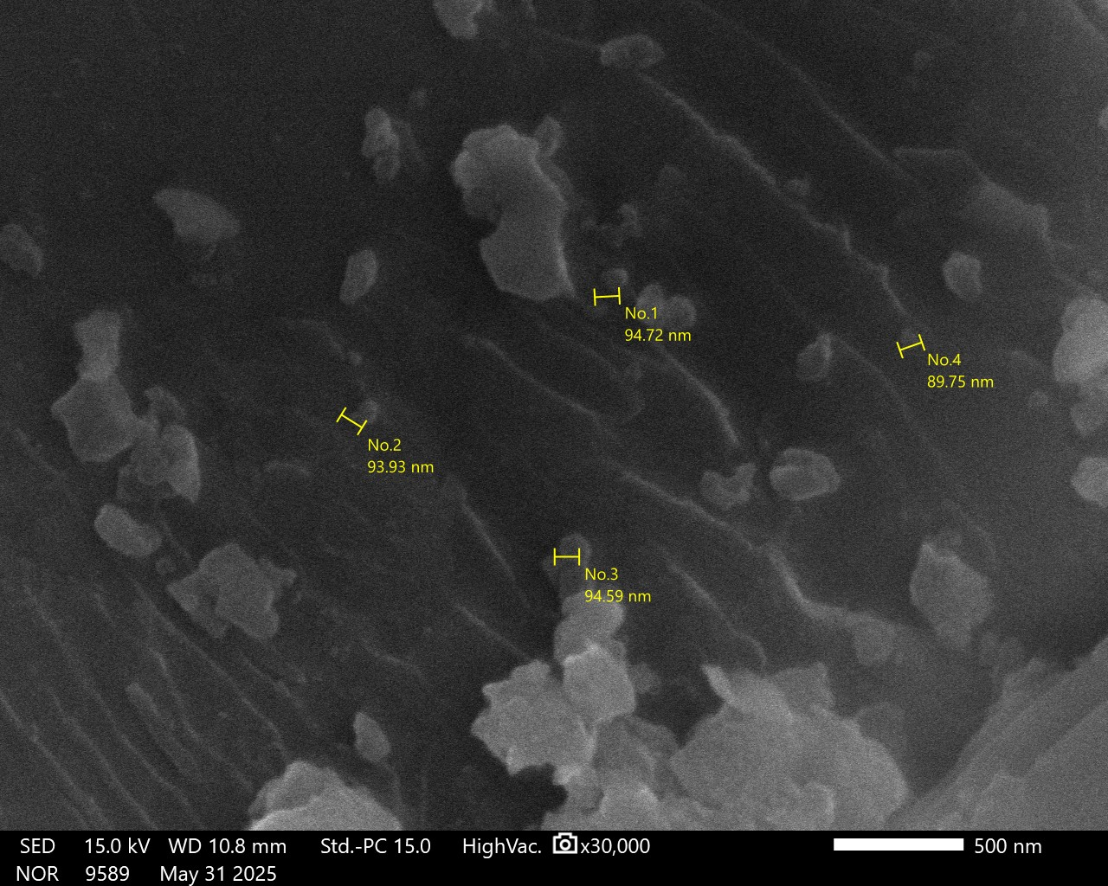
SEM of Nanobiochar
SEM Images of Nanobiochar prepared from banana peel waste (Range between 50 nm – 500 nm).

Slide 13
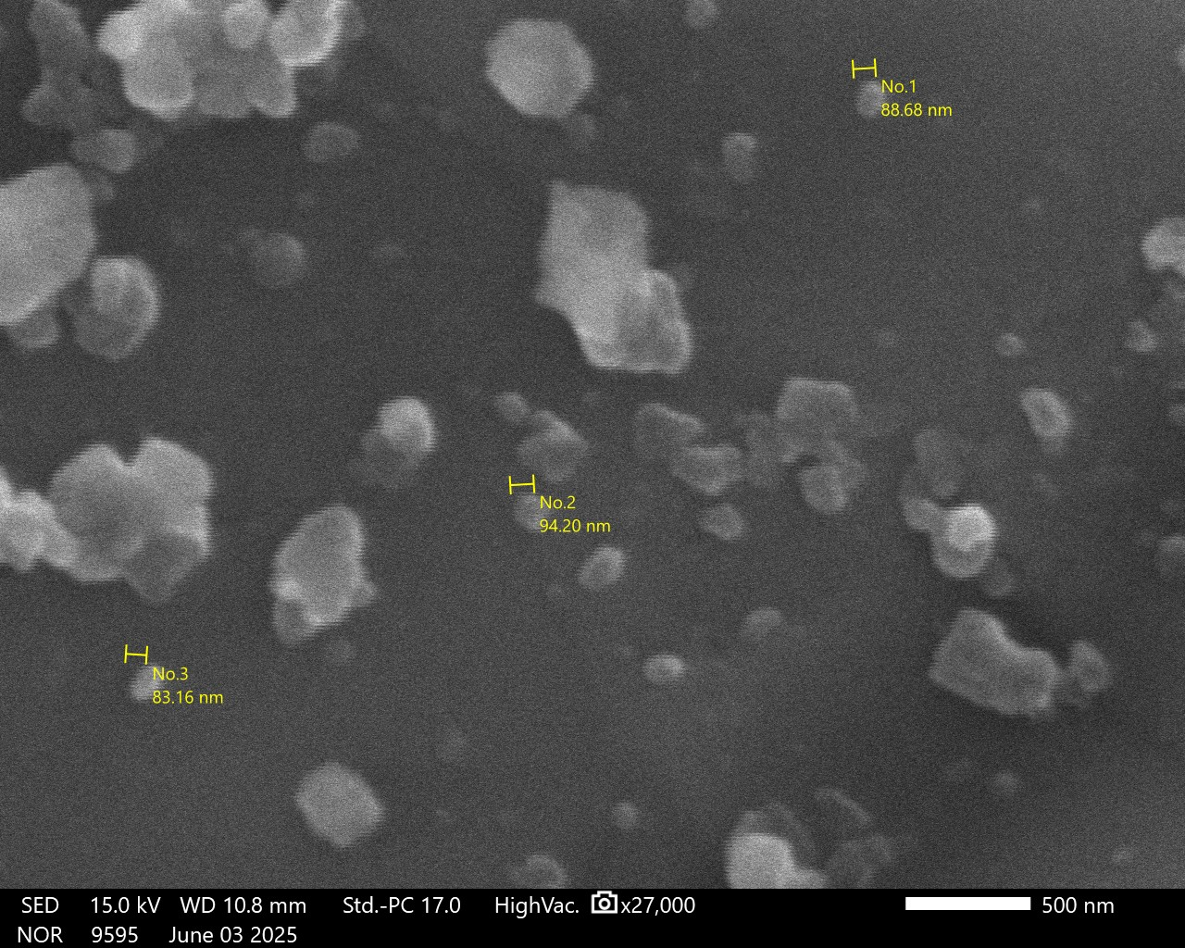
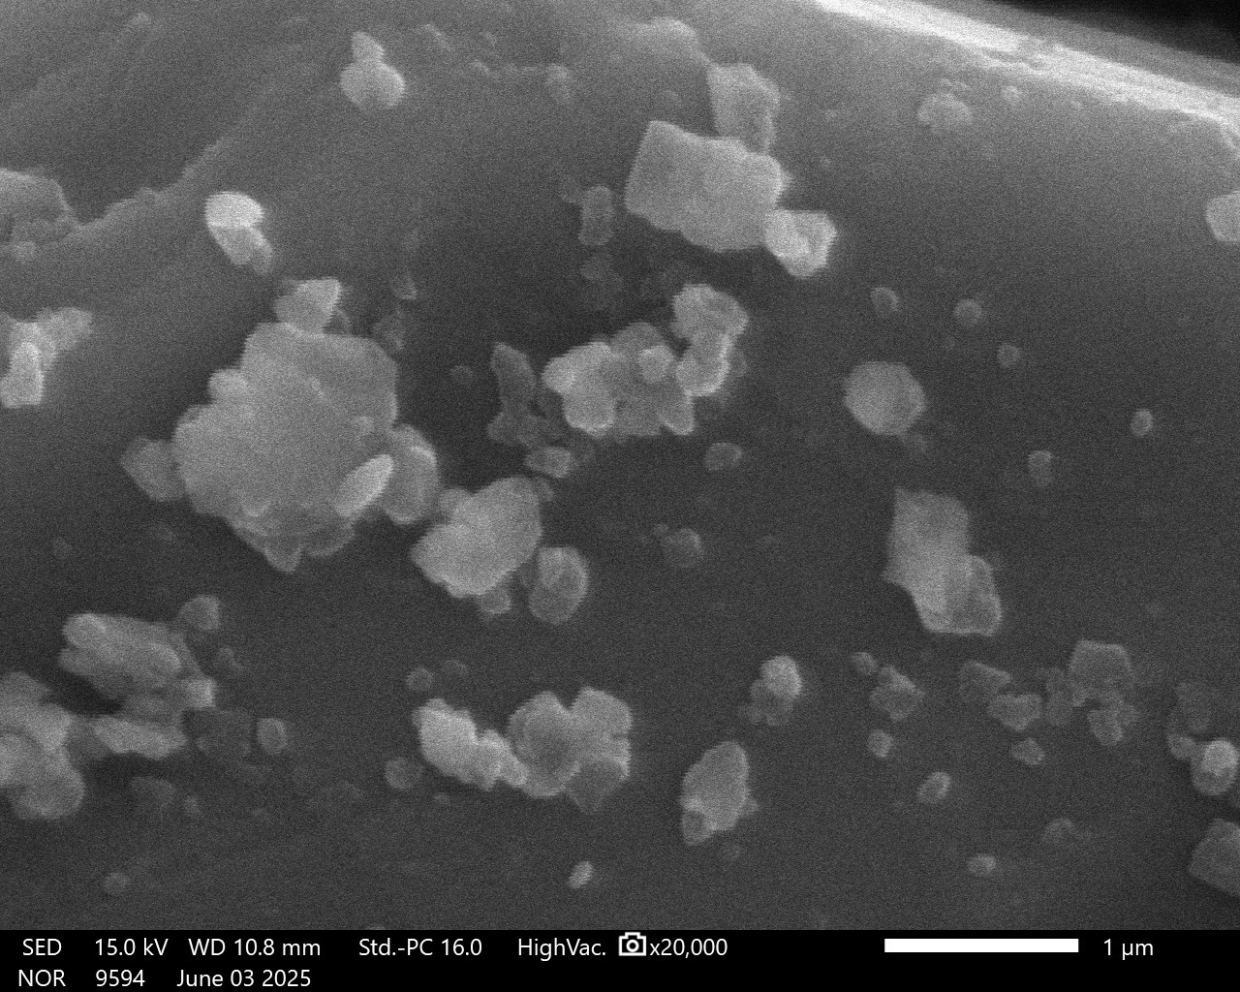
SEM of Potassium NPs
SEM Images of Potassium KNPs prepared from Plant Extract (Range between 50 nm – 500 nm).

Slide 14
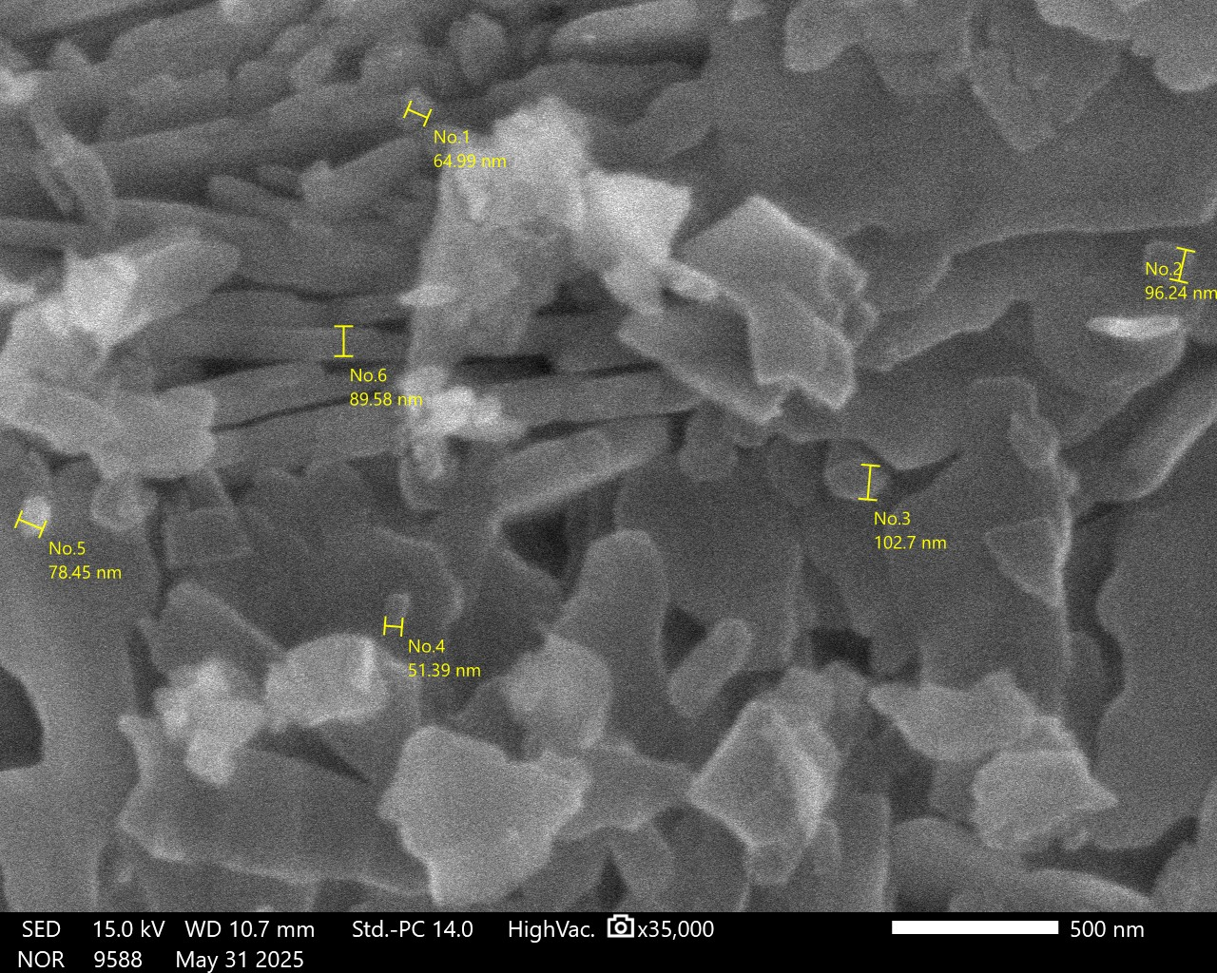
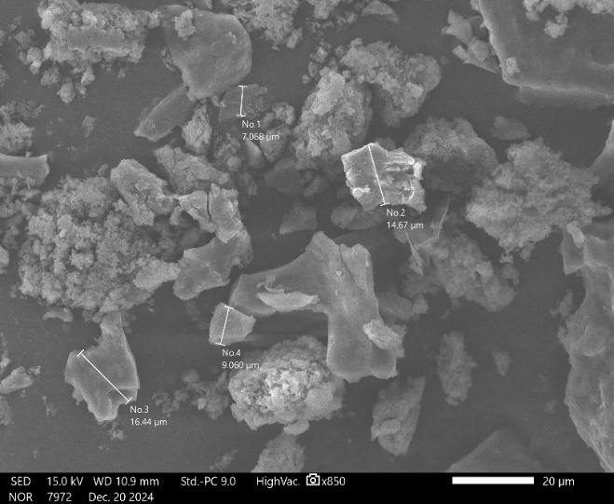
SEM of Chitosan Nanoparticles
SEM Images of chitosan nanoparticles fabricated from sea shrimp waste.
(Range between 51nm – 500 nm).

Slide 15
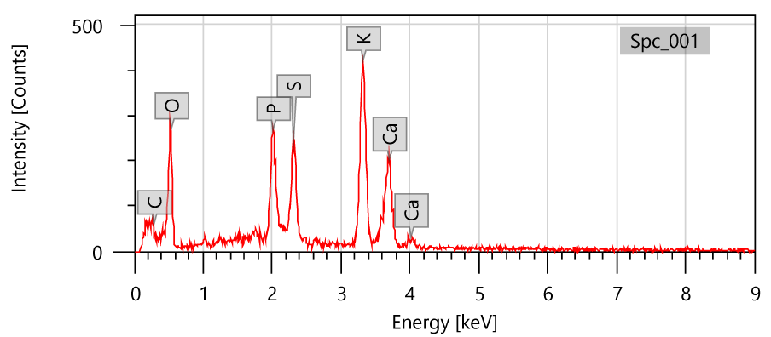
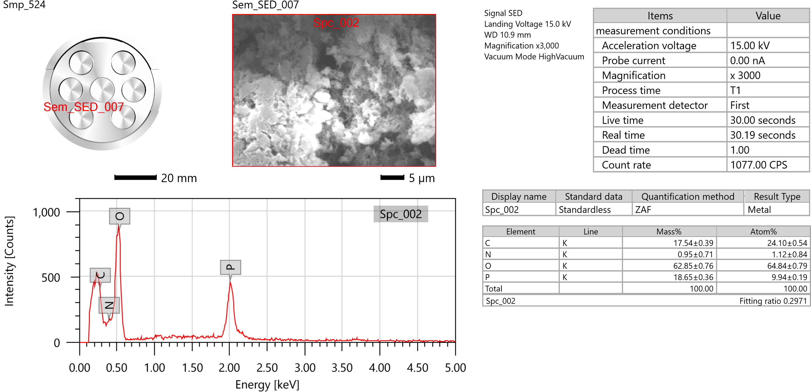
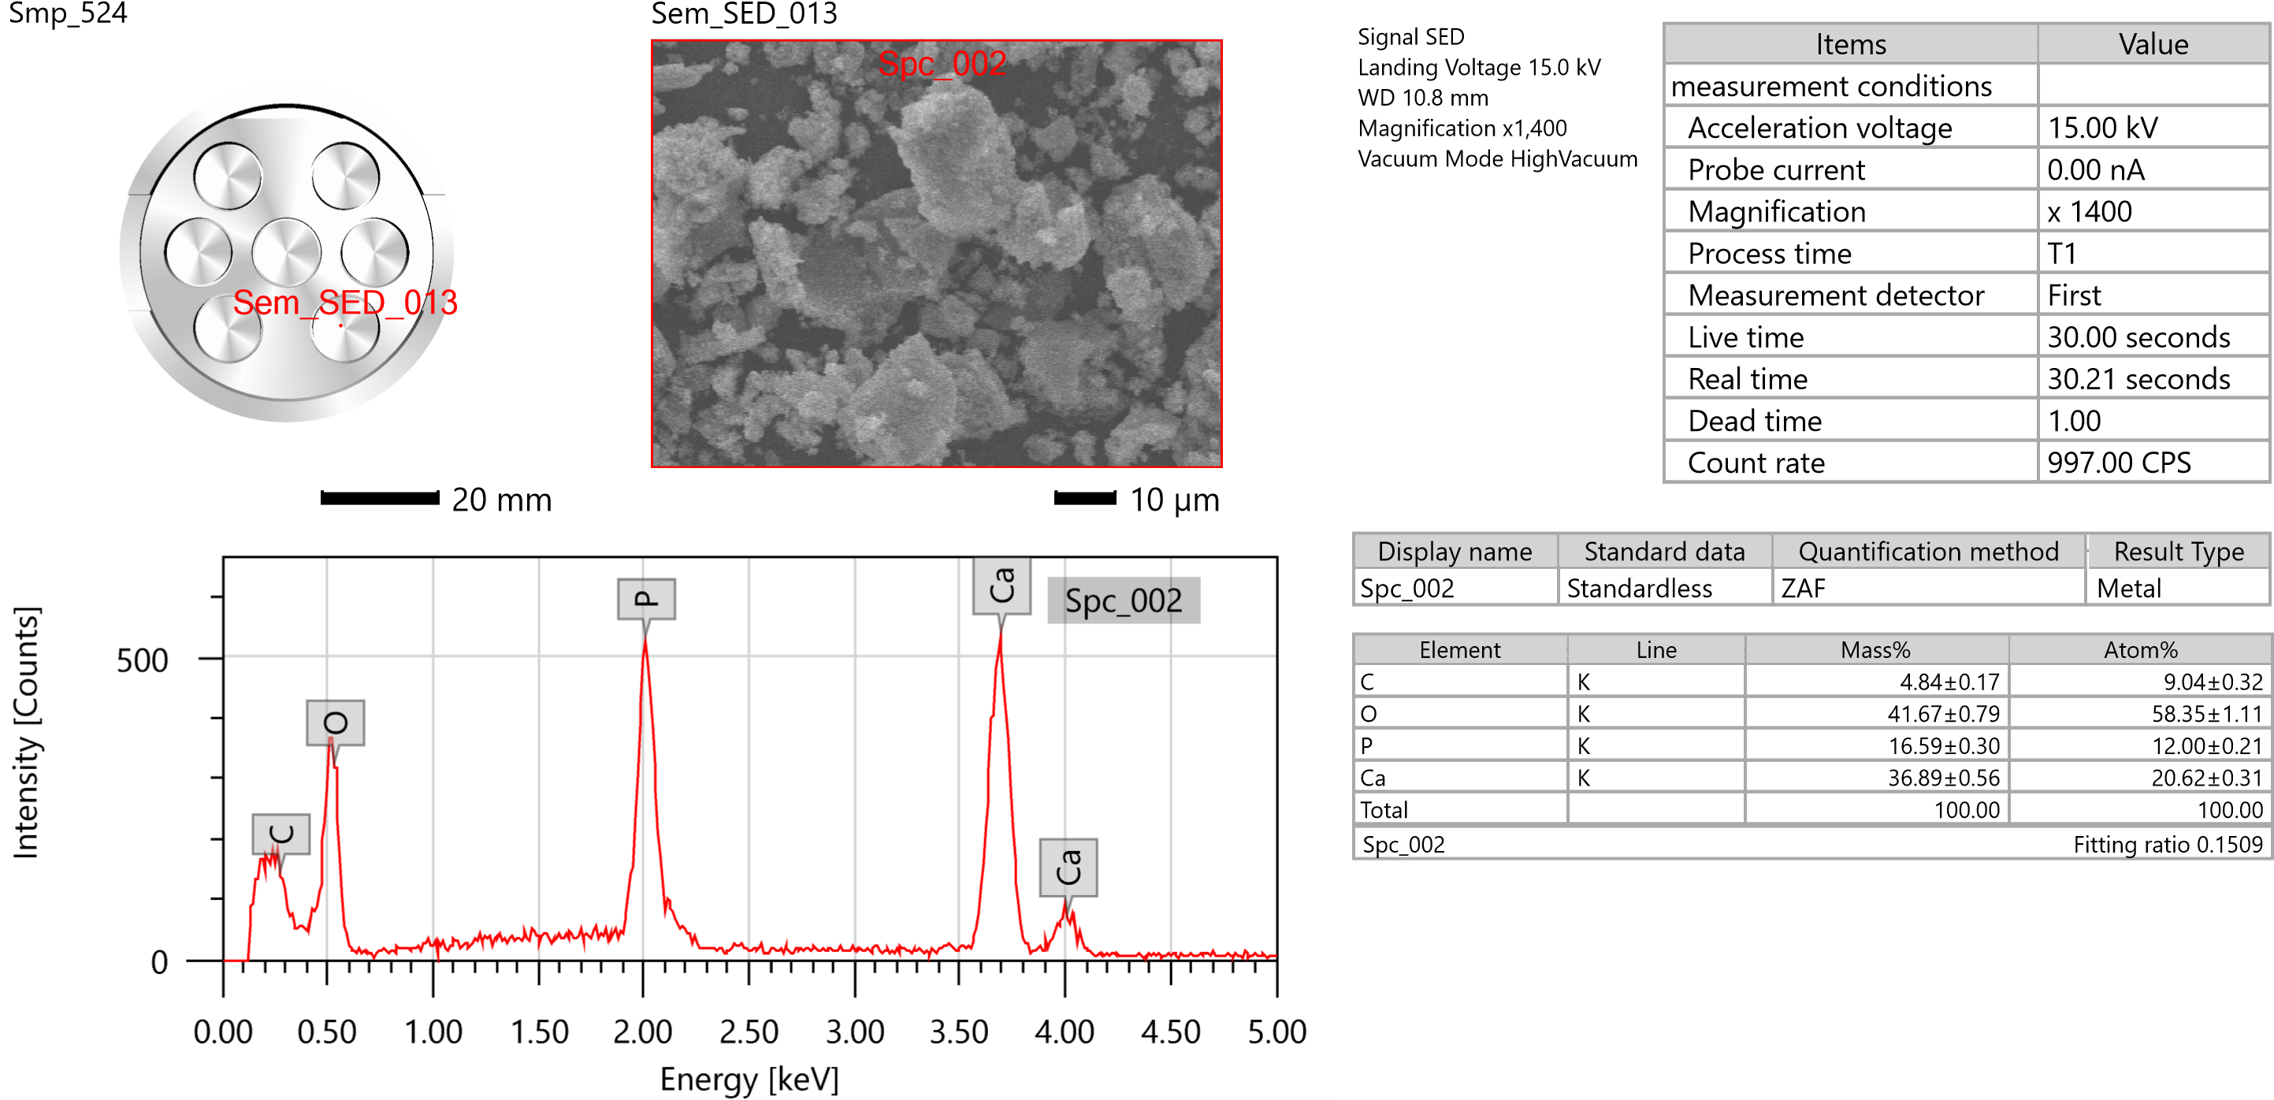
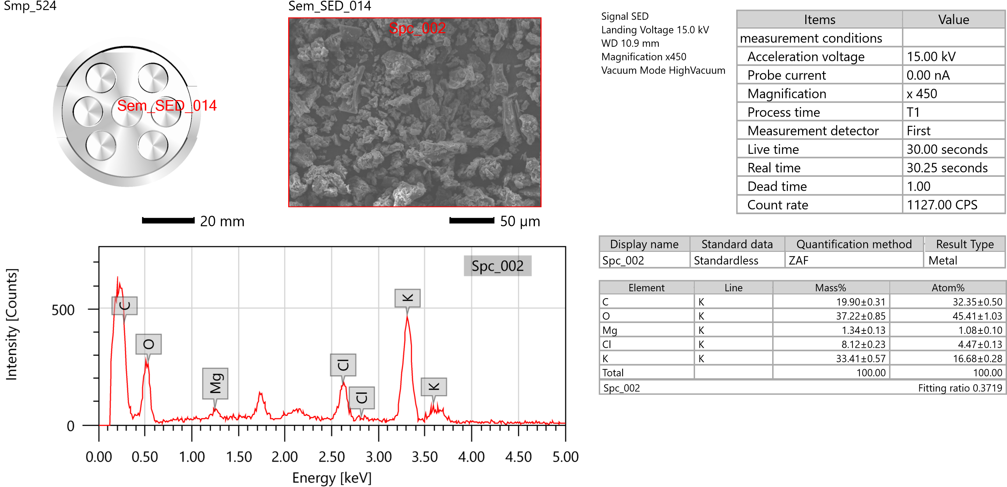
EDS of Nanoparticles
A
B
D
C
EDS of A) Nanobiochar NPs B) Chitosan NPs C) Hydroxyapatite NPs D) Potassium NPs

Slide 16
UV–visible spectra of Nanoparticles
A
B
C
D
UV–spectra of A) Nanobiochar NPs B) Chitosan NPs C) Hydroxyapatite NPs D) Potassium NPs

Slide 17
XRD of Nanoparticles
A
B
C
D
XRD of A) Nanobiochar NPs B) Chitosan NPs C) Hydroxyapatite NPs D) Potassium NPs

Slide 18
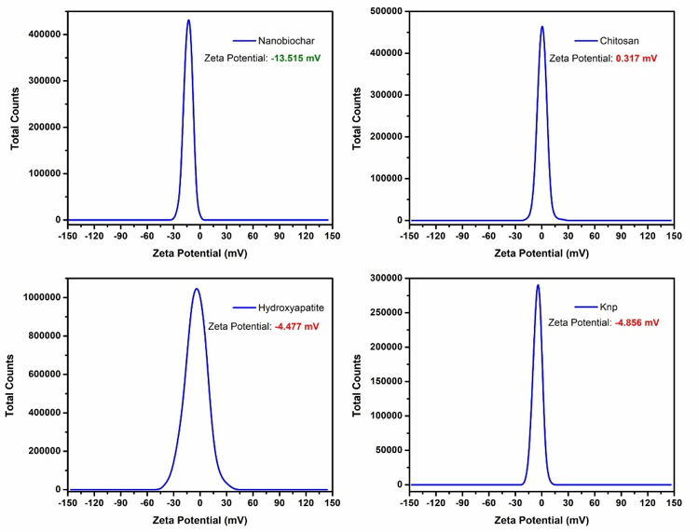
Zeta potential of Nanoparticles
A
B
C
D
Zeta potential of A) Nanobiochar NPs B) Chitosan NPs C) Hydroxyapatite NPs D) Potassium NPs

Slide 19
FTIR of Nanoparticles
A
B
XRD of A) Chitosan NPs B) Potassium NPs

Slide 20
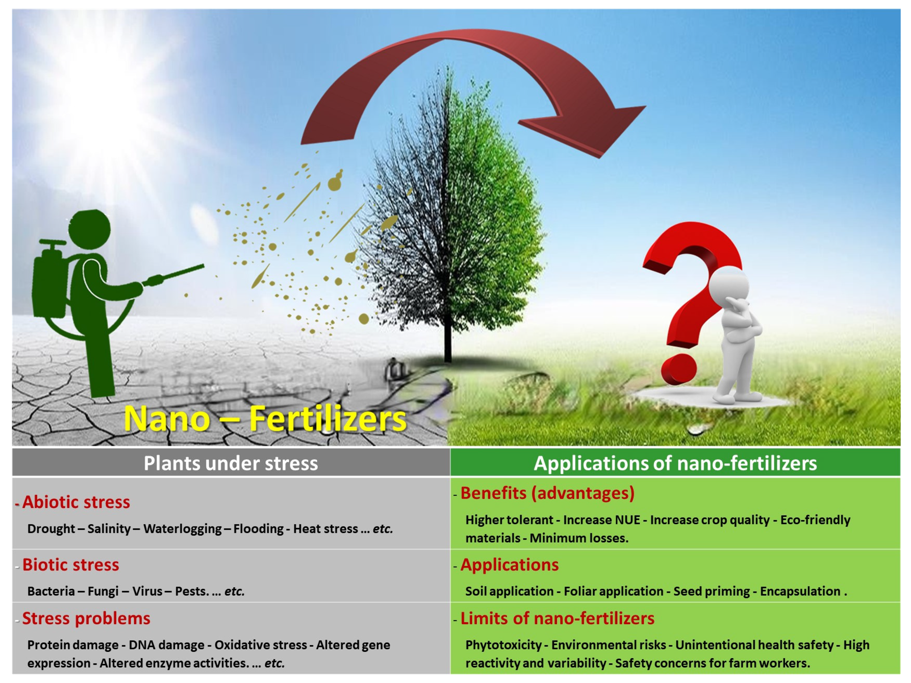
Thank you Queries?

